Slide 1



COVID-19
Navigating the World Pandemic (2020-2021)
The Alpha Data Science Team

Slide 2

Aim of the project :
We will answer these following questions:
What is the relation between the features and COVID-19 Cases & Deaths?
How have COVID-19 cases and deaths varied month by month across continents?
Why the Virus Spread was high in it's earliest stages?
What are the Top 10 Countries with the highest Cases & Deaths?
How do COVID-19 cases and deaths vary globally?
What is the Total number of Corona's Deaths & Cases?
Can we predict next month's COVID-19 Cases?

Slide 3


Data Cleaning
Since our data nature is TimeSeries we cannot use KNNImputer to fill NaNs values
So we used Interpolation (estimating unknown values within the range of known data points)
We will not drop outliers since we will choose a smart complex model that handles outliers perfectly (No spoilers ;)

Slide 4


The Analysis
Each visualization in this project is meant for investigating the different aspects of the COVID-19 data.
Here’s our approach to address each question:

Slide 5
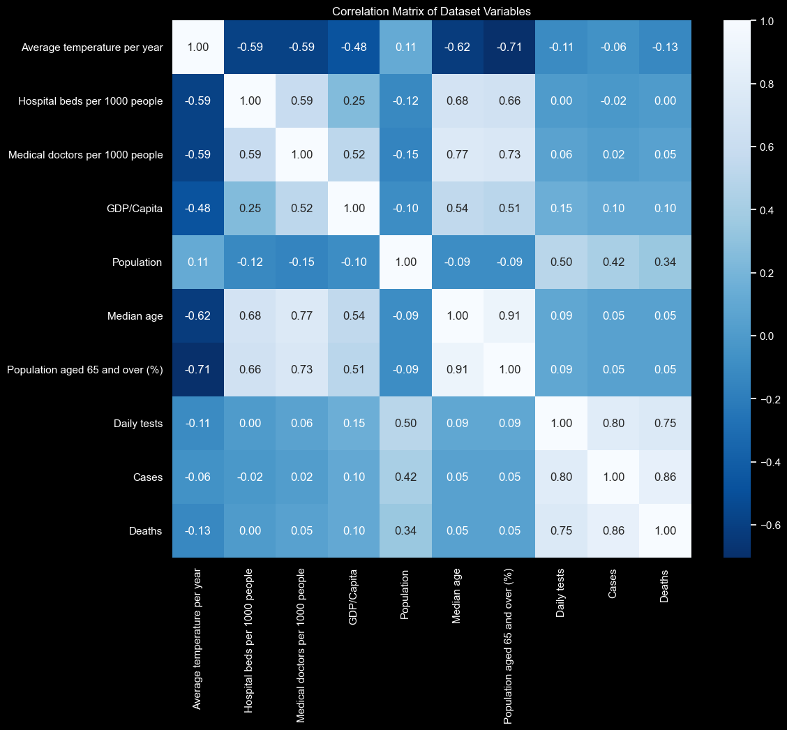

Correlation Matrix
What is the relation between the features and COVID-19 Cases & Deaths?
Strong Correlations:
Cases and Deaths (0.86): this indicates that the more the number of COVID-19 cases increases, the more number of deaths tends to increase as well, which is expected given the nature of the pandemic.
Daily Tests and Cases (0.80), Daily Tests and Deaths (0.75): Regions with more extensive testing report higher numbers of cases and deaths. This may reflect both the spread of the virus and the level of response in terms of testing capacity.
Median Age and Population Aged 65 and Over (0.91): countries with a higher median age typically have a larger percentage of the population aged 65 and over.
NOTE: we will not drop high-correlated feature since we are going to use a smart predictive model in Machine Learning part. (which handles outliers, missing data, also highly-correlated features)

Slide 6

Correlation Matrix
What is the relation between the features and COVID-19 Cases & Deaths?
Strong Correlations:
Cases and Deaths (0.86): this indicates that the more the number of COVID-19 cases increases, the more number of deaths tends to increase as well, which is expected given the nature of the pandemic.
Daily Tests and Cases (0.80), Daily Tests and Deaths (0.75): Regions with more extensive testing report higher numbers of cases and deaths. This may reflect both the spread of the virus and the level of response in terms of testing capacity.
Median Age and Population Aged 65 and Over (0.91): countries with a higher median age typically have a larger percentage of the population aged 65 and over.
Moderate to Weak Correlations:
GDP/Capita and Healthcare Resources: Hospital beds (0.38) and medical doctors (0.43) per 1000 people correlation’s suggest that wealthier countries tend to have better healthcare resources. However, the correlation isn't extremely strong, indicating other factors also play significant roles.
Population and COVID-19 Metrics: The population shows moderate positive correlations with Daily Tests (0.50), Cases (0.42), and Deaths (0.38). This indicates that larger populations tend to have higher absolute numbers of tests, cases, and deaths, but the relationship isn't perfectly linear, suggesting effective response measures can mitigate impacts regardless of population size

Slide 7
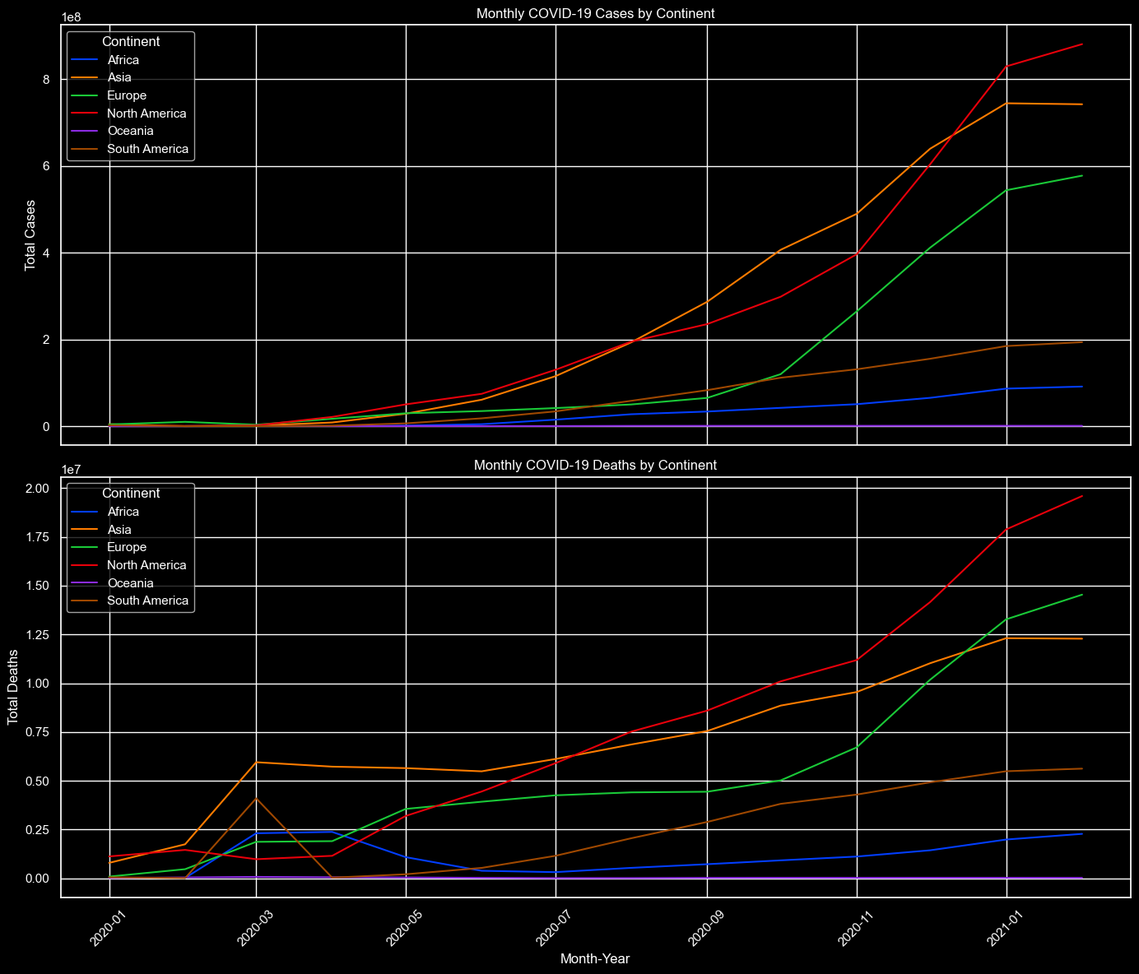

Monthly Cases/Deaths per Continent
2.1. How have COVID-19 cases and deaths varied month by month across continents?
NOTE:
1e7: represents 10,000,000 (10 million).
1e8: represents 100,000,000 (100 million).
1e9: represents 1,000,000,000 (1 billion).

Slide 8
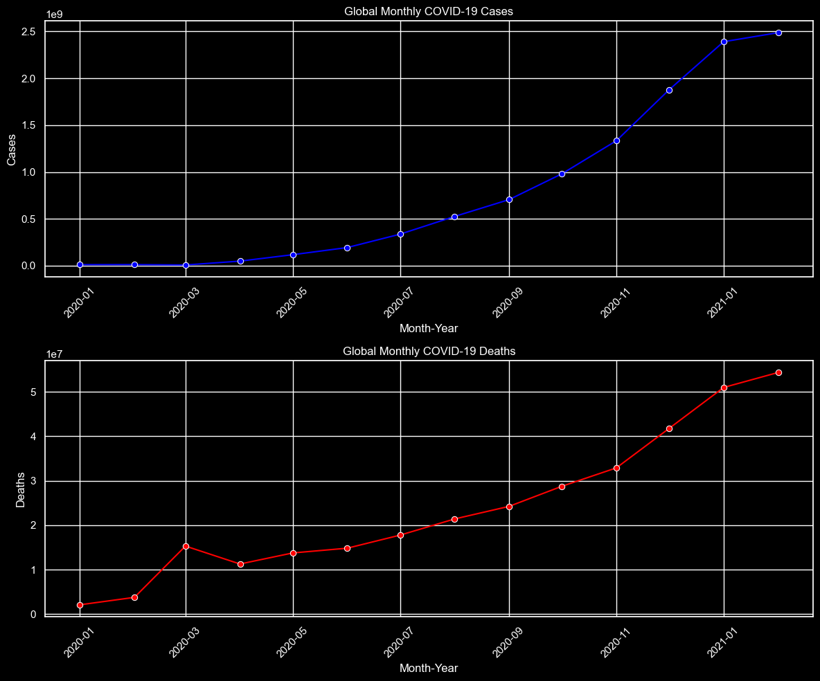

Monthly Cases and Deaths Globally
We notice a peak that occurs between February and April 2020 in Deaths

Slide 9
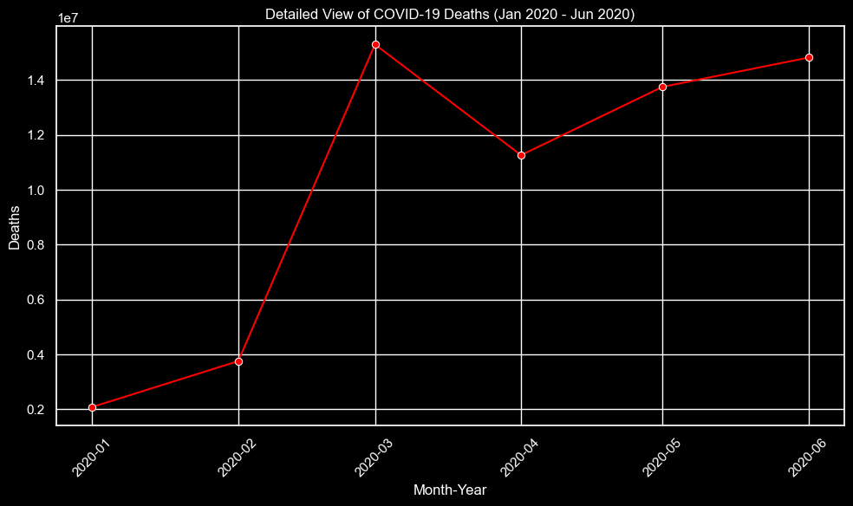

Spread of the virus
3. Why the Virus Spread was high in it's earliest stages?
(Understanding the peak that occurred between 2020-02 & 2020-04)
Analysis
Global Awareness: March 2020 is when many governments and populations began to realize the severity of the pandemic, leading to lockdowns and emergency health measures.
Lag Effect: there's typically a lag between case detection, hospitalizations, and deaths, which means the actions (or inactions) in early 2020 began to show their consequences around this time.
Rapid Spread: In the early stages of the pandemic COVID-19 was spreading rapidly across continents, leading to increased fatalities.

Slide 10
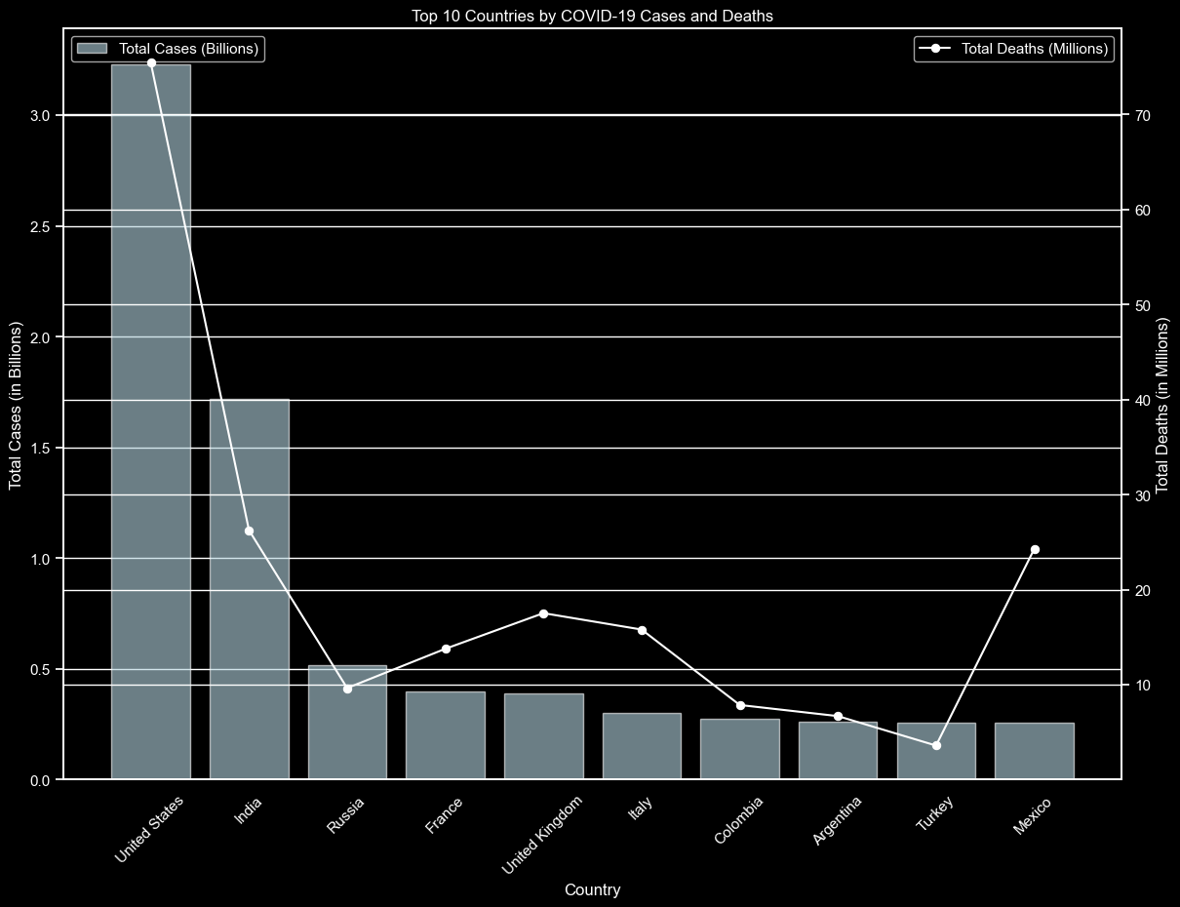

Top 10 Countries with the Cases/Deaths
4. What are the Top 10 Countries with the highest Cases & Deaths?
Insights
U.S.A and India have the highest Total number of Cases and Deaths
NOTE: (The bar chart represents total cases, while the line chart with markers indicates total deaths for these countries)

Slide 11
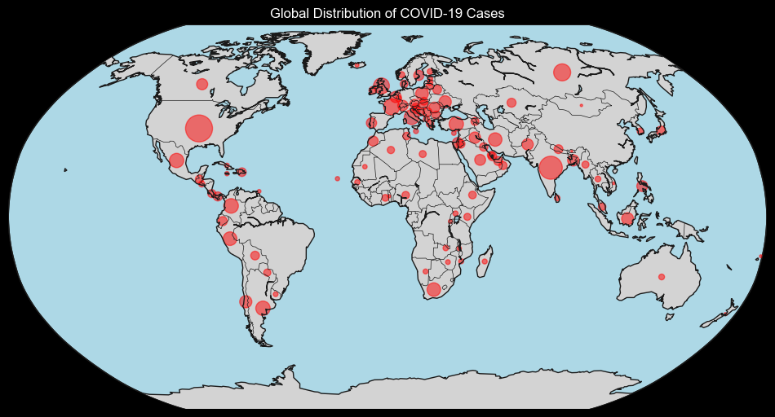
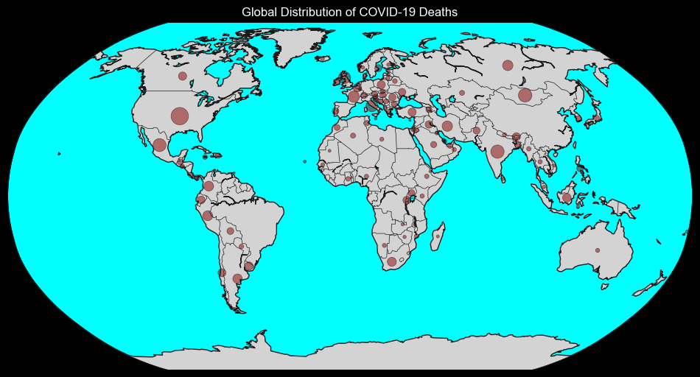

Global Cases/Deaths Distribution
4. How do COVID-19 cases and deaths vary globally?
NOTE: (The red dots indicate the number of deaths and cases that occurred in each country. They don't indicate the area or zone of spreading)

Slide 12
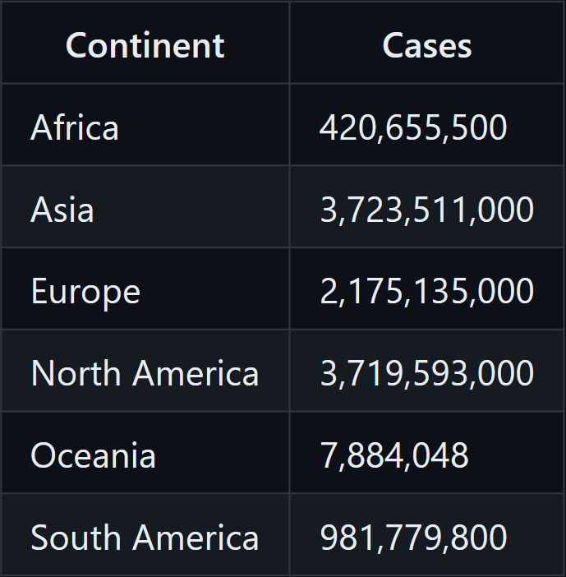
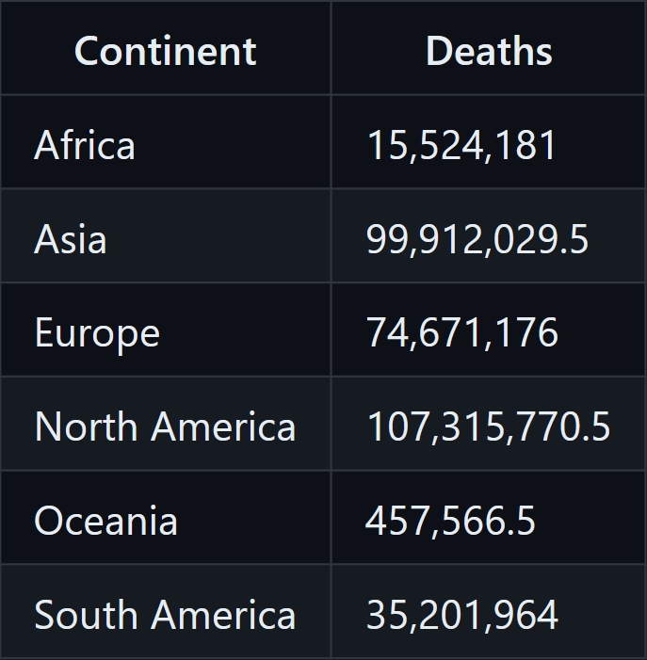

Total Cases/Deaths
5. What is the Total number of Corona's Deaths & Cases?
Insights
Asia and North America reports the highest number of cases and deaths.

Slide 13


Can we predict next month's COVID-19 Cases?
After applying Linear Regression to our data, the model performed bad since the nature of the model is not meant to predict time-series tasks
So to forecast next month's COVID-19 Cases, we've chosen the Prophet model by Facebook, known for handling time series data effectively.

Slide 14

What is FBProphet ?
Prophet is a forecasting tool developed by Facebook for time series analysis and forecasting.
It works by decomposing time series data into its components: trend, seasonality, and holidays
The most important score metrics for evaluating this model are:
trend: captures the overall direction of the time series, whether it is increasing or decreasing over time
yhat: The final forecasted value, the sum of the trend, seasonality, and any other factors the model includes.

Slide 15

Can we predict next month's COVID-19 Cases?
Step 1: Isolating Countries by Continent
Step 2: Model Training (we will divide the dataset into three subsets for training, validation, and cross-validation)
Step 3: Visualizing the Predictions and the Model’s Performance

Slide 16

Calculating Cases increase percentage
After building and applying our Prophet predictive analysis model we used statistics to calculate the percentage of Cases increase in three different continents (Europe, North America, Asia)
Europe: An increase of approximately 1.12%
North America: An increase of approximately 2.51%
Asia: A significant increase of approximately 71.10%

Slide 17
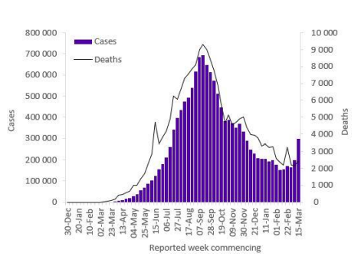

Asia increase % Real-World-Data
To validate the model’s performance and the statistical insights that we
got from Asia’s cases increase %, we compared the results with a plot of
real data from the official website of W.H.O. (World Health Organization)

Slide 18

Evaluating our model
Europe Train Data:
R2 Score: 0.528
Mean Absolute Error (MAE): 24121.570
Mean Squared Error (MSE): 1.809e9
Europe Test Data:
R2 Score: -48.847
Mean Absolute Error (MAE): 37960.300
Mean Squared Error (MSE): 1.567e9
North America Train Data:
R2 Score: 0.227
Mean Absolute Error (MAE): 12133.605
Mean Squared Error (MSE): 2.055e8
North America Test Data:
R2 Score: -2.581
Mean Absolute Error (MAE): 186444.569
Mean Squared Error (MSE): 4.559e10
Asia Train Data:
R2 Score: 0.9998
Mean Absolute Error (MAE): 861.715
Mean Squared Error (MSE): 2.580e6
Asia Test Data:
R2 Score: -0.383
Mean Absolute Error (MAE): 42990.558
Mean Squared Error (MSE): 3.150e9
NOTE : these score metrics might not fully capture model performance, especially in a complex DataFrame like COVID-19 , so we will plot the predictions+evaluation to reveal the trend that is not captured by our model

Slide 19
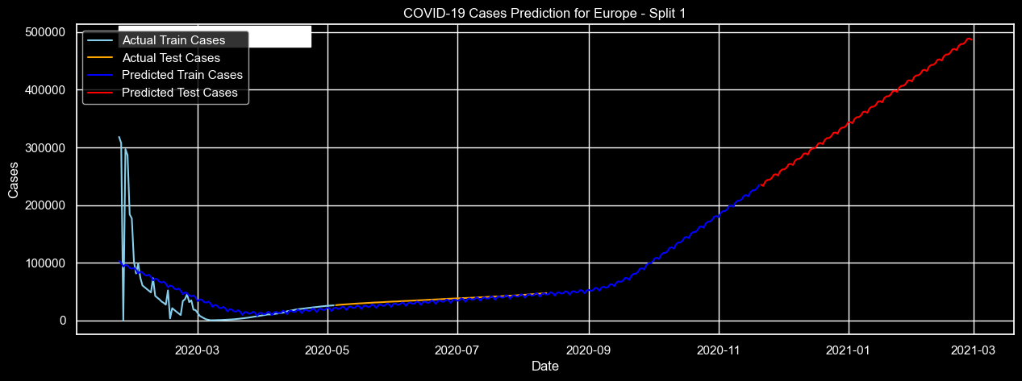
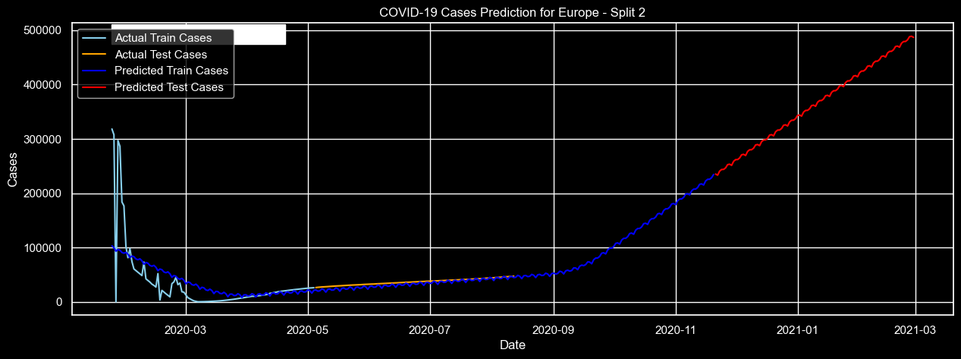


Plotting predictions + Model’s performance
Europe

Slide 20
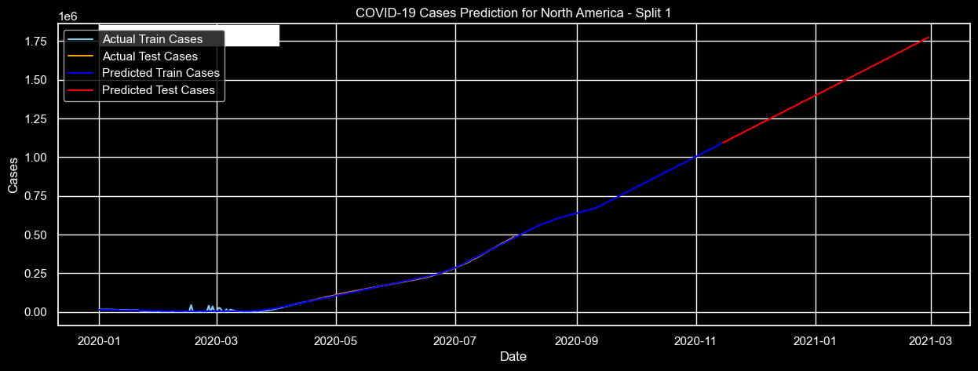



Plotting predictions + Model’s performance
North America

Slide 21
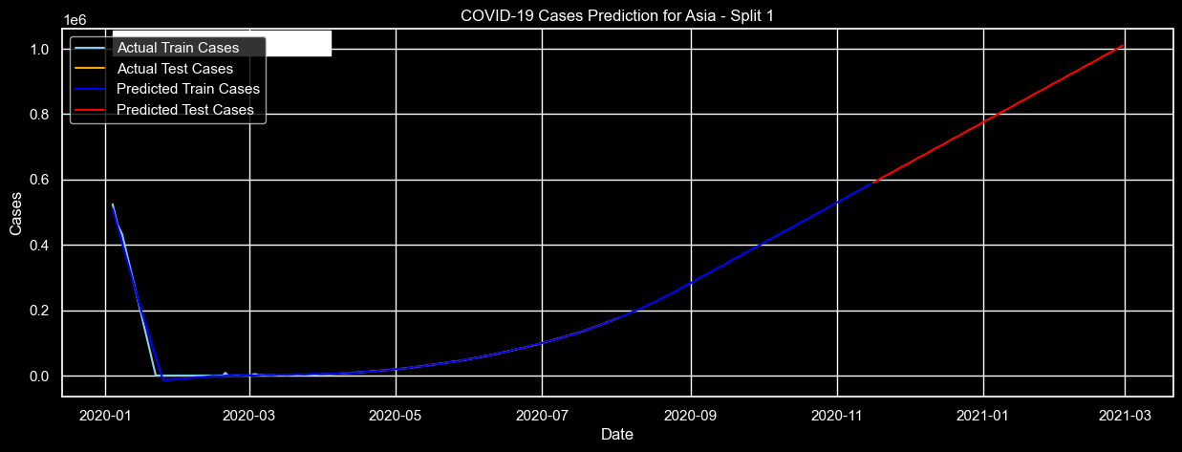
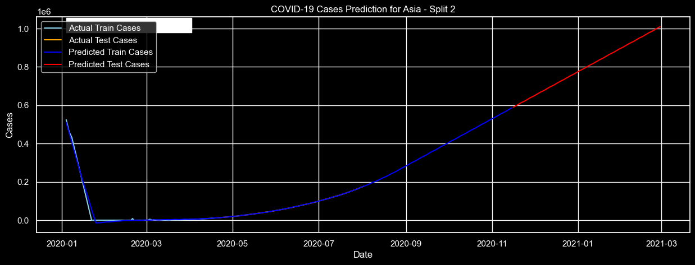


Plotting predictions + Model’s performance
Asia

Slide 22

Key Insights & Conclusion
Key Insights
Europe:
There's a noticeable overestimation during the early pandemic months, but the model adjusts and aligns closely with the actual cases in subsequent months.
North America:
The predictions follow the actual trend closely in both training and testing phases for all splits.
Asia:
For all splits, the test predictions maintain a consistent trend, indicating the model's stability across different time frames.
Conclusion
The predictions indicate that the number of COVID-19 cases increased in each continent during March, suggesting that the virus continued to spread without showing signs of decrease across these regions.

Slide 23







Thank you for watching

